Slide 1
Crystal River primary
Family and Student Support
Information to support you during this time away from school.

Slide 2
We are connected. We are here. Only an email away.
Mrs. West Guidance Counselor:
westj@citrus.k12.fl.us
352-795-2211 EXT 5711
Hours Available: 8-4
Ms. Williams School Social Worker
williamsn@citrusschools.org
352-400-0175
Hours Available: 7:30-3:15
Mrs. Middlemiss School Psychologist
middlemissk@citrus.k12.fl.us
352-462-5759
Hours Available: 7:30-3:30
We are here for support services to you such as check-ins, counseling and resources

Slide 3
Parent and Student Resources

Slide 4
Make sure to stay informed of all the latest news and announcements:
https://crp.citrusschools.org/
https://twitter.com/CitrusSchools
https://www.facebook.com/groups/388044744629287/
http://www.citrus.k12.fl.us

Slide 5
If you need immediate assistance:
EMERGENCY - Call 911
LifeStream 352-228-4770
Citrus County CASA 352-344-8111
National Suicide Prevention Lifeline 1-800-273-8255
Child Abuse Reporting Hotline 1-800-96-ABUSE (962-2873)
National Domestic Violence Hotline 1-800-799-7233
Substance Abuse and Mental Health Helpline 1-800-622-HELP (4357)

Slide 6
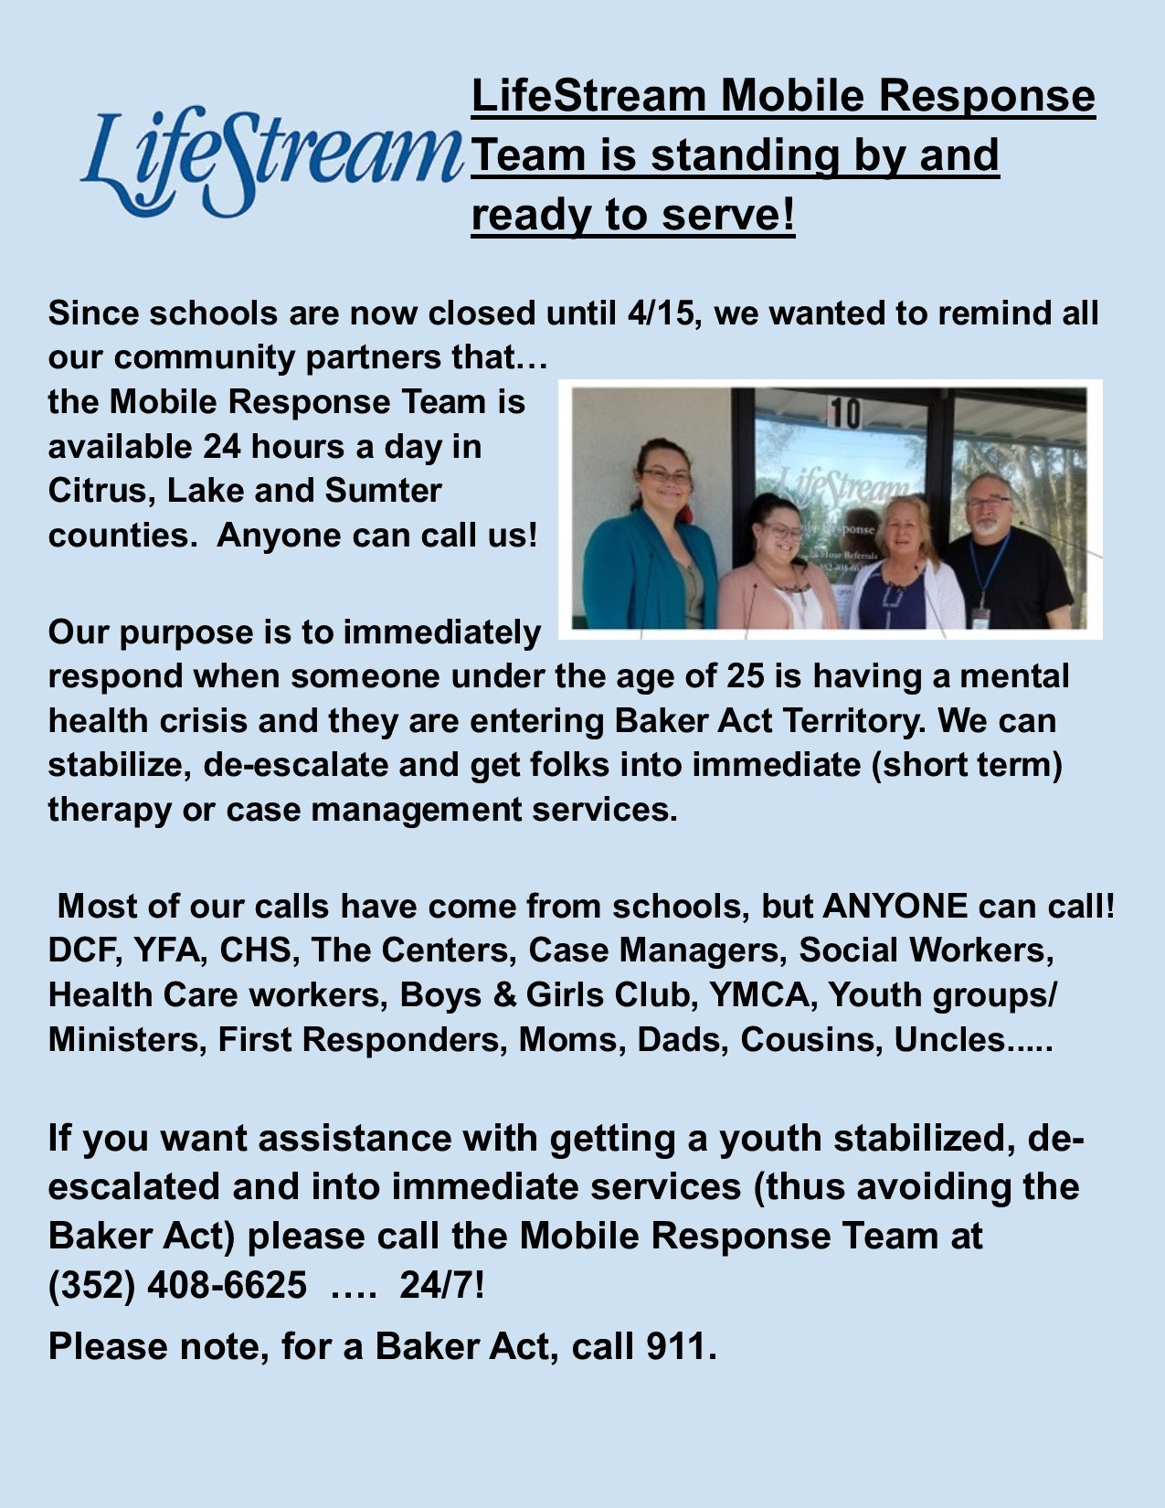
LifeStream Mobile Response Team
(352) 408-6625
Available 24 hrs a day
Immediate response to mental health crisis for anyone under 25
Immediate short term therapy
Case management Services
ANYONE can call

Slide 7
Meal Distribution information
https://www.citrusschools.org/cms/One.aspx?portalId=737701&pageId=26250782

Slide 8
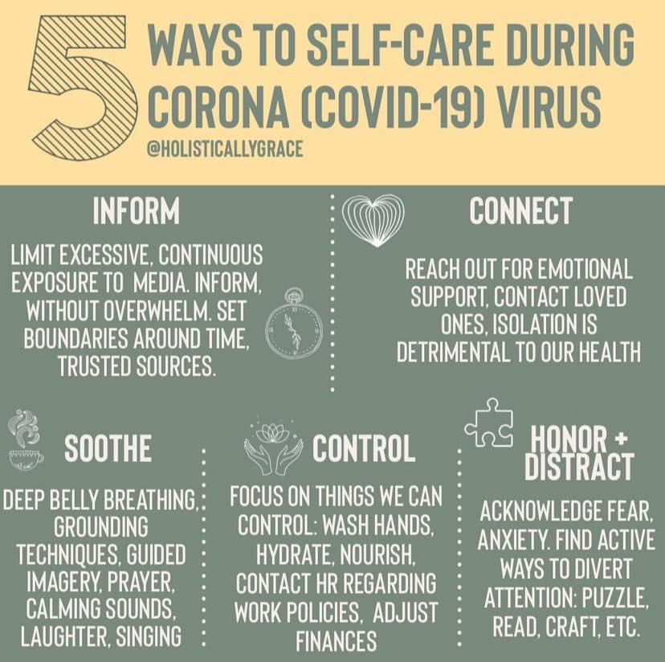
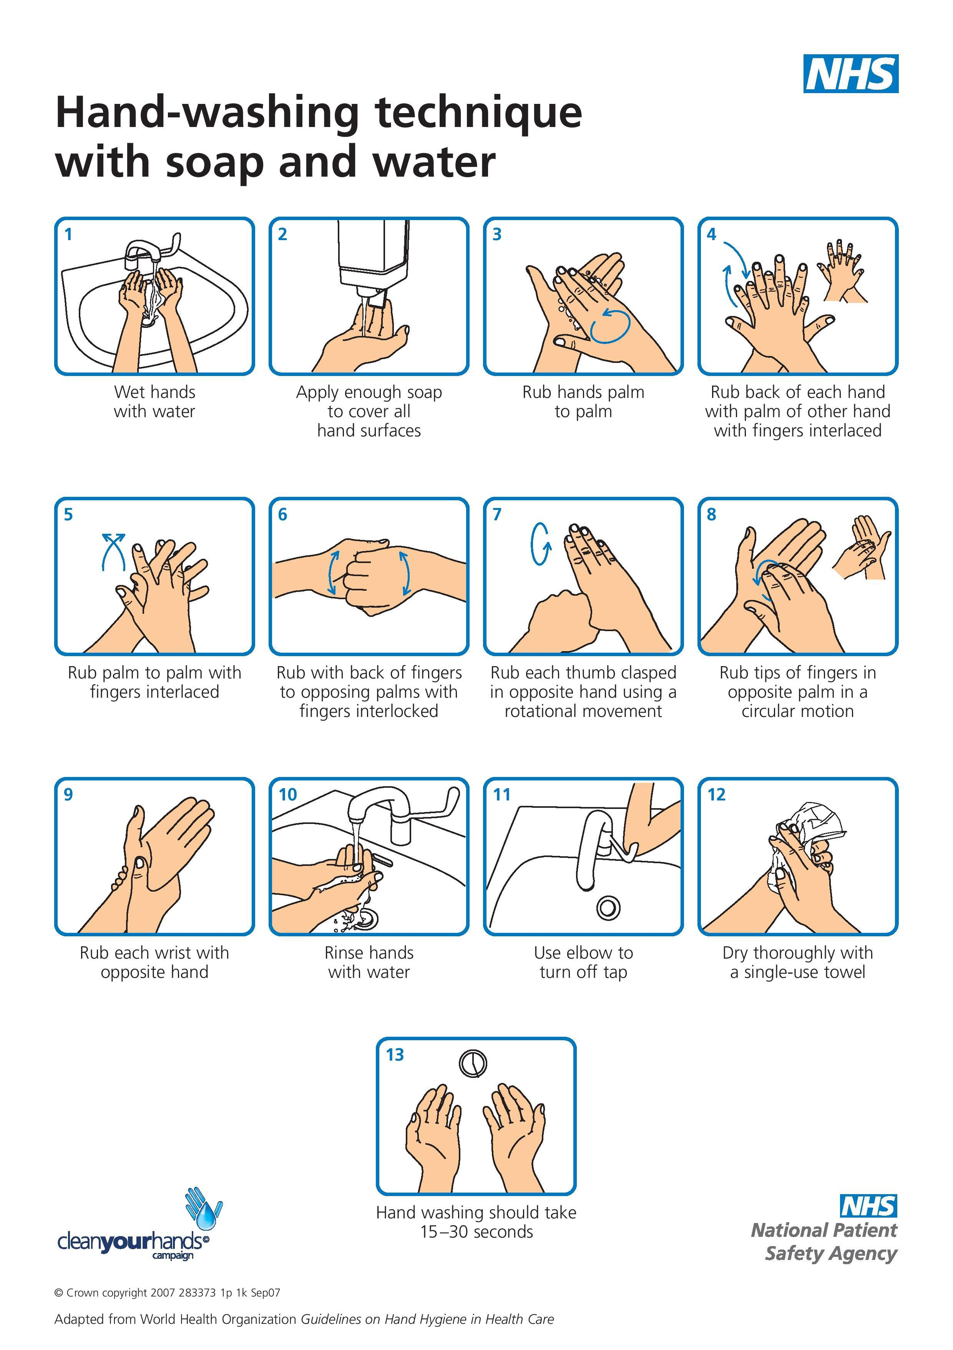
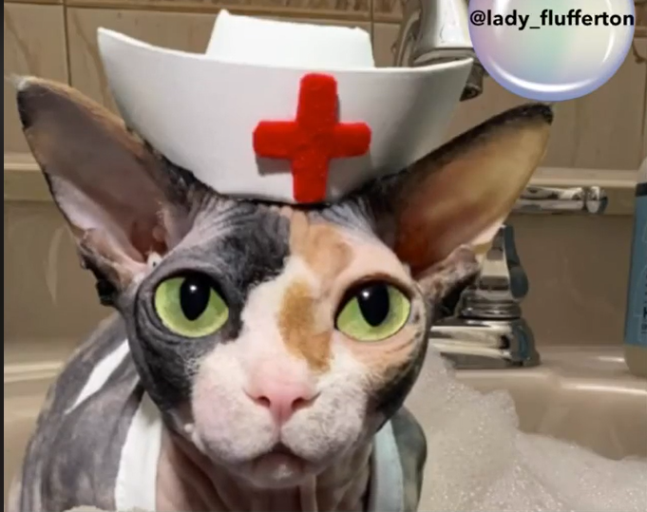
Please watch the video for further instructions:
https://youtu.be/9o77N--JTgA

Slide 9
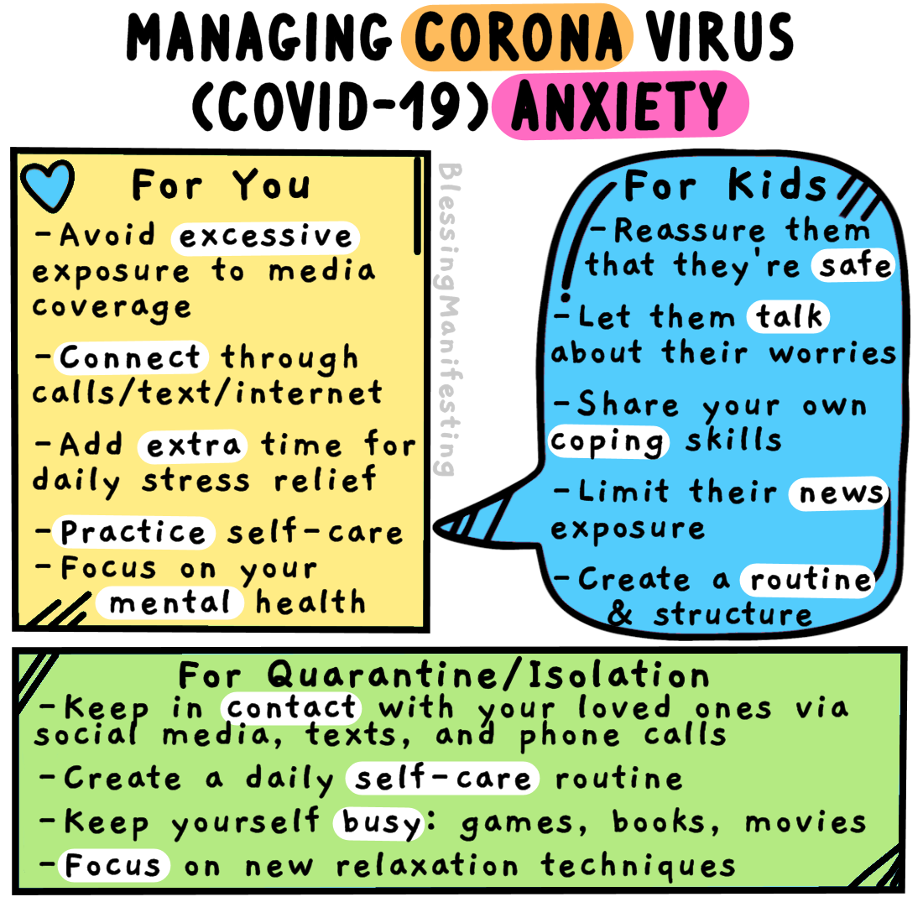

Slide 10
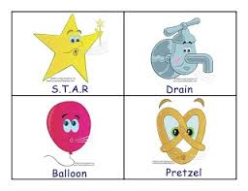
Breathing Exercises
Pretzel Breathing: Stand up and cross your ankles. Cross your right wrist over your left and turn your hands so that your thumbs are facing the floor. Put palms together and interlace fingers. Bend your elbows out and gently turn your hands down and towards your body until they rest on the center of your chest. Put your tongue on the roof of your mouth and relax.
Drain Breathing: Tense every part of your body: your face, arms, stomach, legs- then whoosh! Let it all out! It helps the tension drain out.
S.T.A.R. stands for smile, take a deep breath and relax. You have to raise your arms up in the sky to breathe in and lower them to your sides as you breathe out.
Balloon Breathe: Sit on your chair or floor and cross your legs. Place your hands on your belly with your fingertips forming a circle. As you breath in, try to make your belly bigger, like a balloon blowing up When you breathe out let your belly get smaller. Repeat and Relax.

Slide 11
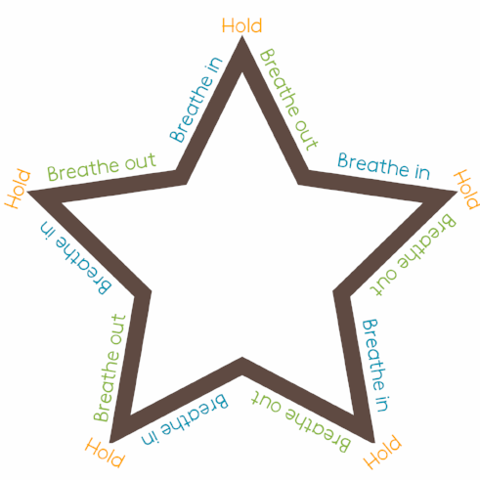
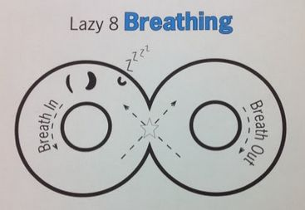
More Breathing Activities
Lazy Eight Breathing: Trace the lazy eight with your finger starting at the star and taking a deep breath in. As you cross over the other side of the lazy eight, let your breath out. Continue breathing around the lazy eight until you have a calm body and mind.

Slide 12
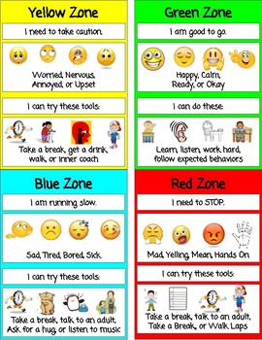
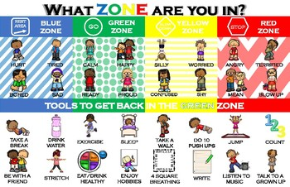
Take a virtual college tour!
Things to do while away from school
While many colleges are cancelling their campus tours, open houses, and preview days, you can take a virtual tour on their site.
Look at their majors...do they have what you are interested in? What are the costs? Any scholarship opportunities?
Other College tours - https://campustours.com/

Slide 13
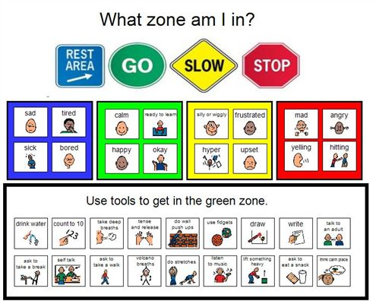
Things to do while away from school
Assess your interests and explore different careers at
MyCareerShines.org

Slide 14
We Miss You All and Are Here For You… We are all part of the CRPS team. Please let us know if you need us or have any questions.
Bear Cubs ROAR!!!

